Slide 1
Flood Risk Prediction and Early Warning System
By Monishaa S 22011101071,Srirangesh S 22011101112

Slide 2
AIM:
To develop a Flood Risk Prediction and A Warning System using DBMS that integrates historical flood data, terrain information, and climate models to predict flood risks and henceforth Provide early warning alerts to residents and authorities, allowing for proactive measures to mitigate damage.
PROBLEM STATEMENT:
In light of the escalating frequency and heightened severity of flooding incidents, there arises an imperative for the development of an advanced Flood Risk Prediction and Warning System. The objective is to construct a sophisticated Database Management System (DBMS) that seamlessly amalgamates historical flood data, terrain particulars, and climate models with the utmost precision for the purpose of predicting flood risks. The resultant system is envisioned to furnish punctual and dependable early warning alerts to both residents and authorities, affording them the opportunity to proactively undertake measures and execute efficacious strategies in order to preemptively address and alleviate potential damages. The Key Objectives of this project include Data Integration, Database Design and Management, Flood Risk Prediction,Early Warning System, User-friendly Interface, Proactive Measures coupled with Mitigation providing Scalability and Reliability.
RESULT:
Our Flood Risk Prediction System works for all regions irrespective of many topological conditions with keen consciousness of the micro errors to provide an early warning which helps the government and the people.
The goal is to provide a Flood Risk Prediction coupled with a Warning system that contributes significantly to enhancing community resilience, reducing property damage, and saving lives in flood-prone regions.

Slide 3
REQUIREMENT GATHERING
Designing a database management system(DBMS) for a Flood Risk Prediction System coupled with a warning system which involves identifying entd ities, Relationships, and attributes relevant to the application. Below is a relational database schema for the same.
Requirement gathering for Flood Risk Prediction and warning system involves understanding the needs of the problem statement and a suitable implementation of the idea for the optimal solution.
Entities:
1. Location:
- LocationID (Primary Key)
- Latitude
- Longitude
- Region
- Elevation
2. HistoricalFloodData:
- FloodDataID (Primary Key)
- LocationID (Foreign Key referencing Location.LocationID)
- Date
- Magnitude
- Duration

Slide 4
3. EarlyWarningAlert:
- AlertID (Primary Key)
- LocationID (Foreign Key referencing Location.LocationID)
- DateIssued
- AlertLevel
- RecommendedActions
4. PreventiveMeasure:
- MeasureID (Primary Key)
- LocationID (Foreign Key referencing Location.LocationID)
- MeasureType
- Description
- ImplementationDate
5. Resident:
- ResidentID (Primary Key)
- Name
- Address
- ContactNumber
- LocationID (Foreign Key referencing Location.LocationID)
6. Authority:
- AuthorityID (Primary Key)
- Name

Slide 5
- Organization
- ContactNumber
- LocationID (Foreign Key referencing Location.LocationID)
7. EmergencyResponsePlan:
- PlanID (Primary Key)
- LocationID (Foreign Key referencing Location.LocationID)
- PlanDescription
- ActivationDate
8. EmergencyResponseLog:
- LogID (Primary Key)
- LocationID (Foreign Key referencing Location.LocationID)
- Date
- Time
- LogDetails
9. EvacuationCenter:
- CenterID (Primary Key)
- LocationID (Foreign Key referencing Location. LocationID)
- CenterName
- Capacity
- Location Details

Slide 6
RELATIONSHIPS:
One-to-Many with HistoricalFloodData (One Location can have Many HistoricalFloodData entries).
One-to-Many with EarlyWarningAlert (One Location can have Many EarlyWarningAlert entries).
Many-to-One with Location (Many HistoricalFloodData entries can be associated with One Location).
Many-to-One with Location (Many EarlyWarningAlert entries can be associated with One Location).
Many-to-One with Location (Many PreventiveMeasures can be associated with One Location).
Many-to-One with Location (Many Residents can be associated with One Location).
Many-to-One with Location (Many Authorities can be associated with One Location).
Many-to-One with Location (Many EmergencyResponsePlans can be associated with One Location).
Many-to-One with Location (Many EmergencyResponseLogs can be associated with One Location).
Many-to-One with Location (Many EvacuationCenters can be associated with One Location).

Slide 7
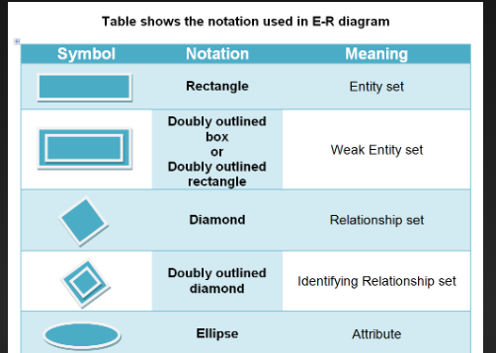
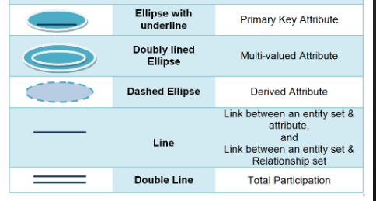
DESIGN USING ER DIAGRAM
AIM:
To brainstorm and create an ER Diagram for our project that is titled “Advanced Flood Risk Prediction and Warning System”.
ER DIAGRAM:
An Entity Relationship (ER) Diagram is a type of flowchart that illustrates how “entities” such as people, objects or concepts relate to each other within a system. ER Diagrams are most often used to design or debug relational databases.

Slide 8
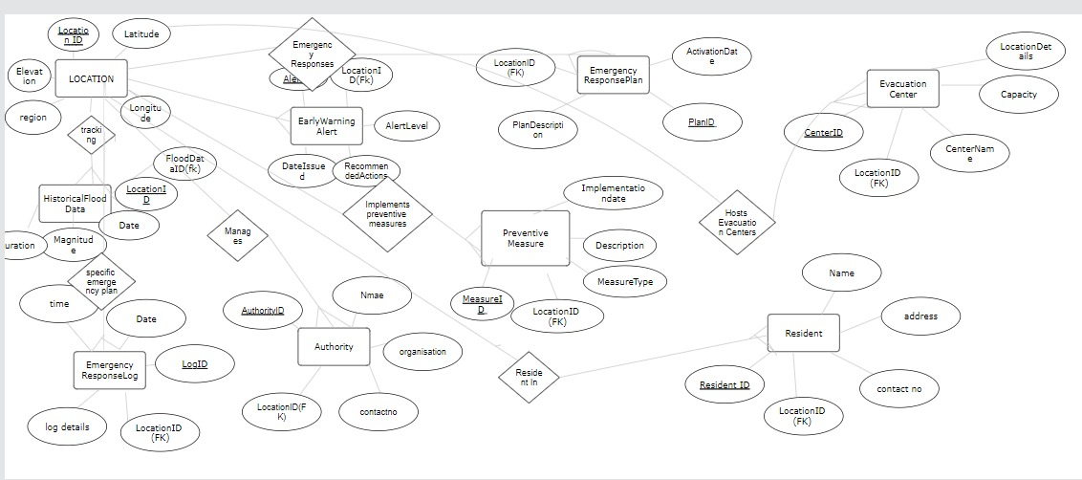
ER DIAGRAM:
The ER diagram for AquaAlert succinctly outlines the database structure for its Flood Risk Prediction and Early Warning System. It highlights key entities like Location, HistoricalFloodData, and EarlyWarningAlert, showcasing their relationships and interactions. By illustrating one-to-many associations and cardinality constraints, the diagram provides a clear blueprint for data management and analysis. This visual representation serves as a crucial guide for designing an efficient database architecture, enabling accurate flood risk predictions and timely alerts for residents and authorities. Ultimately, the ER diagram plays a pivotal role in AquaAlert's mission to enhance community resilience and mitigate the impact of floods.

Slide 9
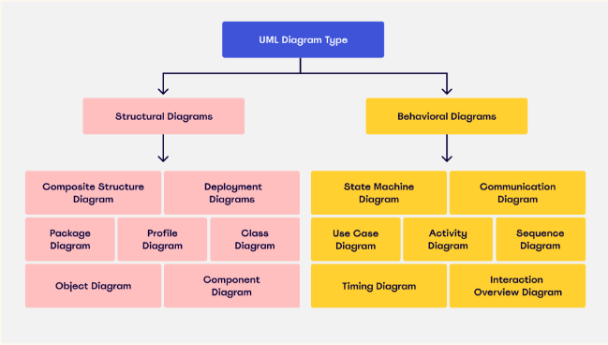
RESULT:
Therefore, an ER diagram for the topic Advanced Flood Risk Prevention and Early warning Database System has been designed successfully based on the given requirements.
ARCHITECTURE OF DIAGRAMS
AIM:
To understand the conceptually, the implantation part holds a huge role for it. A UML Diagram helps to visualize the system or progress of the project over time and its current situation. Errors can be reduced if detected.
Here’s a breakdown of the different types of UML diagrams and whether they’re classified as a structural diagram or behavioral diagram:

Slide 10
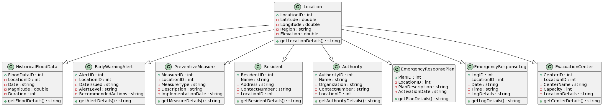
UML CLASS DIAGRAM:
A class diagram is a visual representation of the structure and relationships within a system, illustrating classes, their attributes, and methods. It provides a high-level view of the system's architecture, showcasing the static elements and their associations.

Slide 11
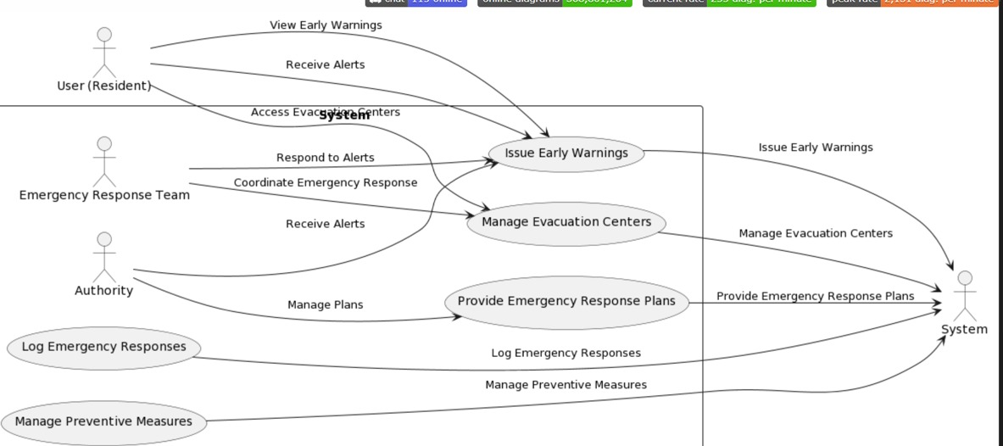
USE CASE DIAGRAM:
A use case diagram outlines the interactions between users and a system, illustrating various scenarios or use cases. It captures the functionalities a system offers from an external perspective, showcasing how actors (users) interact with the system to achieve specific goals.

Slide 12
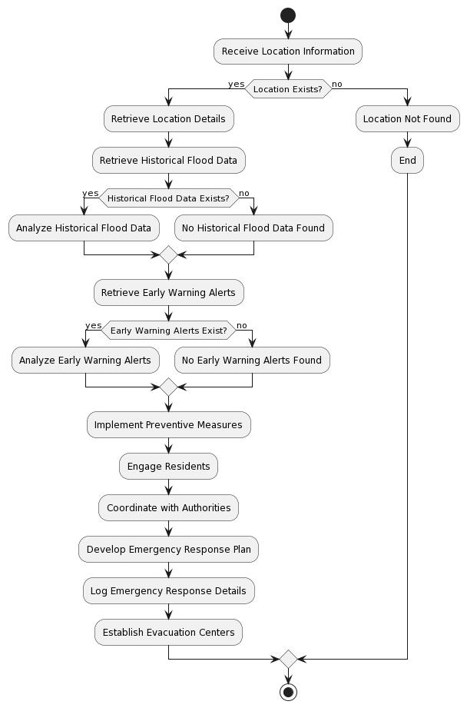
ACTIVITY DIAGRAM:
An activity diagram visually represents the flow of activities within a system, demonstrating the sequential steps and decision points in a process. It is particularly useful for modeling workflows and business processes, highlighting the dynamic aspects of system behavior.

Slide 13
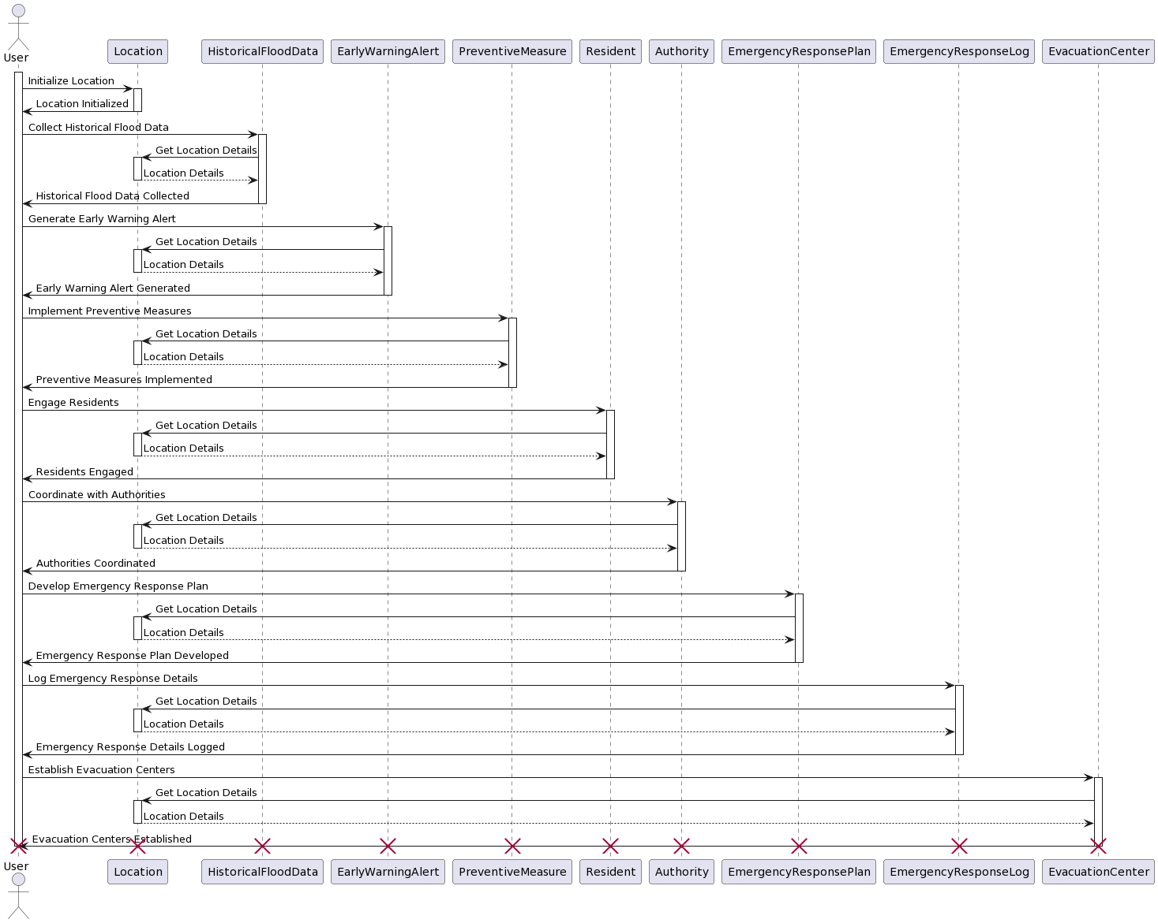
SEQUENCE DIAGRAM:
A sequence diagram depicts the interactions between objects in a system over time, illustrating the order of messages exchanged among them. It provides a dynamic view of system behavior, showing how objects collaborate to accomplish specific tasks or scenarios.

Slide 14
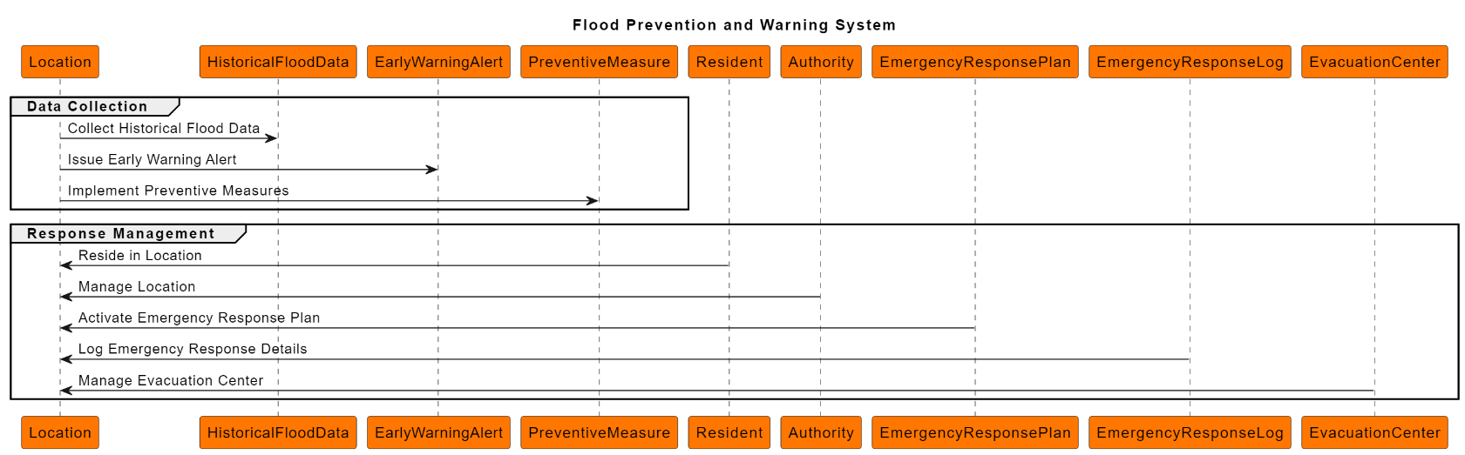
TIMING DIAGRAM:
A timing diagram portrays the timing aspects of interactions between objects in a system, emphasizing the durations of messages and the lifetimes of objects. It offers insights into the temporal aspects of a system's behavior, helping to understand the synchronization and timing constraints in a scenario.

Slide 15
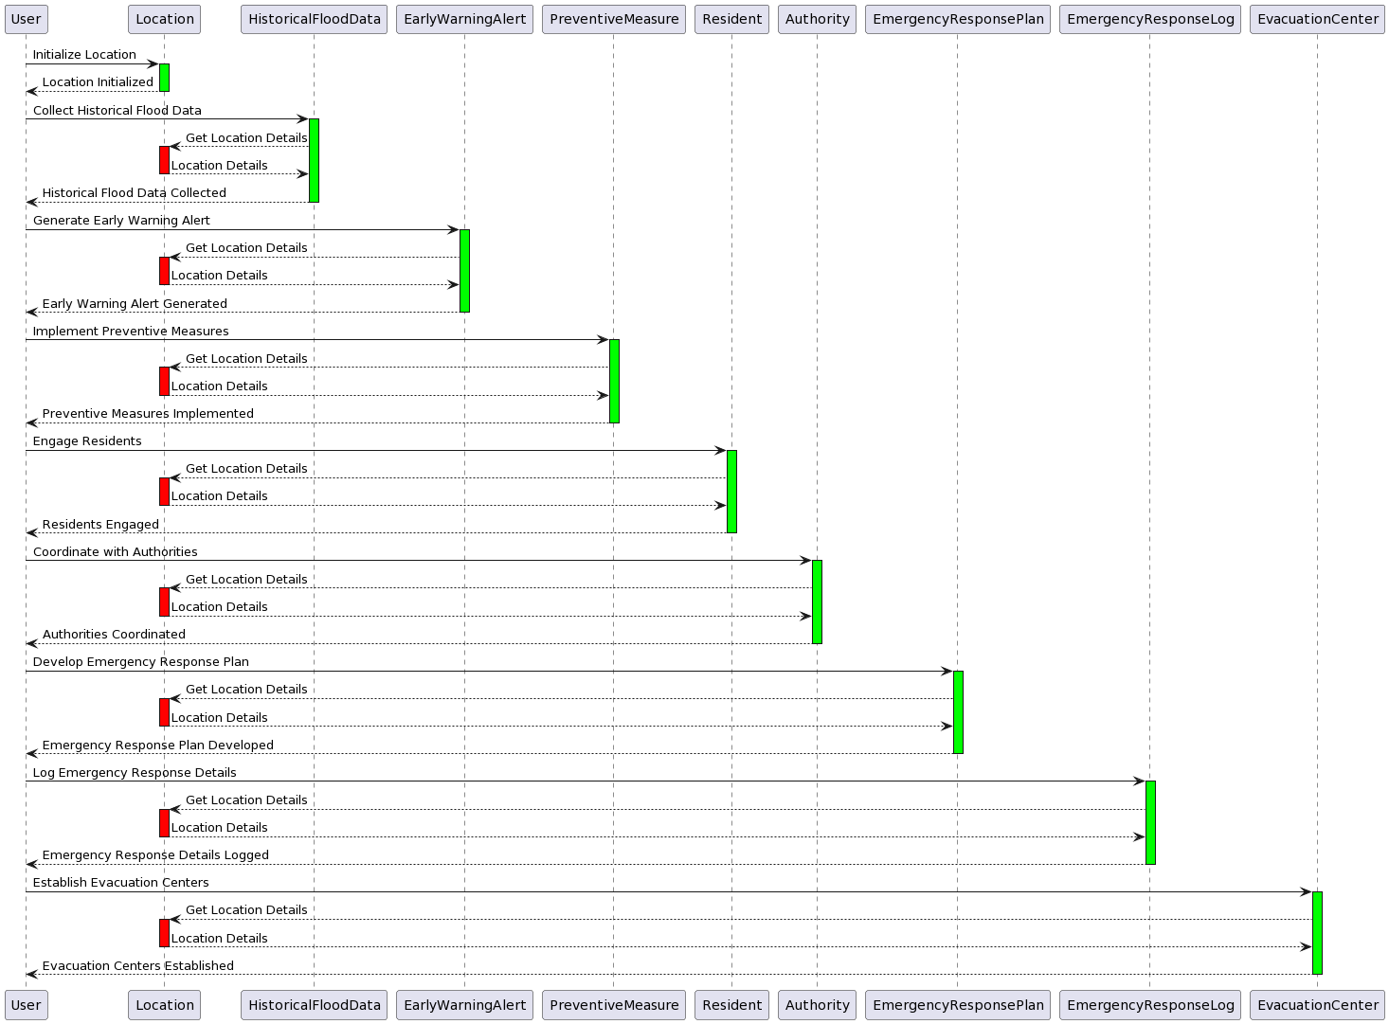

Slide 16
CONVERTING ER DIAGRAM TO TABLE
AIM:
To understand the conceptually, the implantation part holds a huge role for it. To convert the Entity relationship diagram to tables and create data inside to feature and practice implementation through the venture of structured query language. SQL is a programming language which offers insights about the data inside the tables.
LIST OF TABLES:
Location Table
Historical Flood Data Table
Early Warning Alert Table
Preventive Measure Table
Resident Table
Authority Table
Emergency Response Plan Table
Emergency Response Log Table
Evacuation Center Table

Slide 17
1)LOCATION TABLE:
LocationID | Latitude | Longitude | Region | Elevation
---------------------------------------------------------
1 | 40.7128 | -74.0060 | New York | 10
2 | 34.0522 | -118.2437 | Los Angeles | 15
3 | 51.5074 | -0.1278 | London | 20
4 | 48.8566 | 2.3522 | Paris | 30
5 | 35.6895 | 139.6917 | Tokyo | 25
6 | 37.7749 | -122.4194 | San Francisco | 12
7 | 40.4168 | -3.7038 | Madrid | 22
8 | 37.9838 | 23.7275 | Athens | 18
9 | 41.9028 | 12.4964 | Rome | 28
10 | 55.7558 | 37.6176 | Moscow | 35
2)HISTORICAL FLOOD DATA TABLE:
FloodDataID | LocationID | Date | Magnitude | Duration
------------------------------------------------------------
1 | 1 | 2022-01-05 | 4 | 48
2 | 2 | 2022-02-12 | 3 | 36
3 | 3 | 2022-03-20 | 5 | 72
4 | 4 | 2022-04-18 | 3.5 | 24
5 | 5 | 2022-05-25 | 4.5 | 60
6 | 6 | 2022-06-10 | 3 | 48
7 | 7 | 2022-07-15 | 4 | 36
8 | 8 | 2022-08-22 | 3.5 | 24
9 | 9 | 2022-09-30 | 5 | 72
10 | 10 | 2022-10-18 | 4.5 | 60

Slide 18
3)EARLY WARNING ALERT TABLE:
AlertID | LocationID | DateIssued | AlertLevel |RecommendedActions
--------------------------------------------------------------------
1 | 1 | 2022-01-03 | High | Evacuate
2 | 2 | 2022-02-10 | Moderate | Stay Alert
3 | 3 | 2022-03-18 | High | Prepare
4 | 4 | 2022-04-15 | Low | Monitor
5 | 5 | 2022-05-22 | Moderate | Prepare
6 | 6 | 2022-06-08 | High | Evacuate
7 | 7 | 2022-07-13 | Low | Monitor
8 | 8 | 2022-08-20 | Moderate | Prepare
9 | 9 | 2022-09-28 | High | Evacuate
10 | 10 | 2022-10-15 | Low | Monitor

Slide 19
4)PREVENTIVE MEASURE TABLE:
MeasureID | LocationID | MeasureType | Description ImplementationDate
--------------------------------------------------------------------------------------------------
1 | 1 | Structural | Reinforcement of riverbanks | 2022-01-15
2 | 2 | Early Warning | Installation of flood sensors | 2022-02-20
3 | 3 | Community | Conducting awareness campaigns | 2022-03-25
4 | 4 | Infrastructure | Upgrading drainage systems | 2022-04-30
5 | 5 | Evacuation | Establishment of evacuation routes | 2022-05-10
6 | 6 | Monitoring | Implementing real-time monitoring | 2022-06-15
7 | 7 | Preparedness | Training emergency response teams | 2022-07-20
8 | 8 | Communication | Enhancing public communication channels| 2022-08-25
9 | 9 | Equipment | Procurement of emergency supplies | 2022-09-05
10 | 10 | Technology | Implementing GIS-based flood modeling | 2022-10-10

Slide 20
5)RESIDENT TABLE:
ResidentID | Name | Address | ContactNumber | LocationID
---------------------------------------------------------------------------------
1 | John Doe | 123 Main St, City | 123-456-7890 | 1
2 | Jane Smith | 456 Oak Ave, Town | 456-789-0123 | 2
3 | David Johnson| 789 Elm Rd, Village | 789-012-3456 | 3
4 | Sarah Brown | 321 Pine Blvd, Suburb | 321-654-9870 | 4
5 | Emily Wilson | 567 Maple Dr, Hamlet | 567-890-1234 | 5
6 | Michael Lee | 901 Cedar Ln, County | 901-234-5678 | 6
7 | Laura Miller | 234 Birch St, Township| 234-567-8901 | 7
8 | Kevin Clark | 678 Walnut Ave, Parish| 678-901-2345 | 8
9 | Amanda White | 890 Spruce Rd, Borough| 890-123-4567 | 9
10 | Eric Taylor | 345 Oakwood Dr, Manor | 345-678-9012 | 10

Slide 21
6)AUTHORITY TABLE:
AuthorityID | Name | Organization | ContactNumber | LocationID
---------------------------------------------------------------------------------
1 | Mark Anderson | City Emergency Dept | 111-222-3333 | 1
2 | Lisa Williams | County Disaster Team | 444-555-6666 | 2
3 | James Wilson | Township Fire Dept | 777-888-9999 | 3
4 | Sarah Brown | Parish Police Dept | 000-111-2222 | 4
5 | Michael Clark | Village Emergency | 333-444-5555 | 5
6 | Emma Johnson | Borough Rescue Squad | 666-777-8888 | 6
7 | Ryan Martinez| Hamlet Emergency | 999-000-1111 | 7
8 | Rachel Lee | Town Disaster Relief | 222-333-4444 | 8
9 | David White | County Emergency | 555-666-7777 | 9
10 | Jessica Taylor| Township Rescue | 888-999-0000 | 10

Slide 22
7)EMERGENCY RESPONSE TABLE:
PlanID | LocationID | PlanDescription | ActivationDate
---------------------------------------------------------------------------------
1 | 1 | Emergency Evacuation Plan for City | 2022-01-01
2 | 2 | Disaster Preparedness Plan for County | 2022-02-05
3 | 3 | Town Emergency Response Plan | 2022-03-10
4 | 4 | Parish Crisis Management Plan | 2022-04-15
5 | 5 | Hamlet Disaster Recovery Plan | 2022-05-20
6 | 6 | County Emergency Action Plan | 2022-06-25
7 | 7 | Township Disaster Management Plan | 2022-07-30
8 | 8 | Village Emergency Preparedness Strategy | 2022-08-05
9 | 9 | Borough Contingency Plan | 2022-09-10
10 | 10 | Manor Disaster Response Framework | 2022-10-15

Slide 23
8)EMERGENCY RESPONSE LOG TABLE:
LogID | LocationID | Date | Time | LogDetails
-------------------------------------------------------
1 | 1 | 2022-01-02 | 09:00 | Flood monitoring initiated
2 | 2 | 2022-02-08 | 12:30 | Warning alert issued for flooding
3 | 3 | 2022-03-12 | 15:45 | Activation of emergency response teams
4 | 4 | 2022-04-20 | 10:15 | Drainage system inspection completed
5 | 5 | 2022-05-18 | 11:20 | Evacuation routes marked and verified
6 | 6 | 2022-06-24 | 08:45 | Real-time monitoring system activated
7 | 7 | 2022-07-28 | 14:00 | Training session conducted for responders
8 | 8 | 2022-08-30 | 16:30 | Public communication channels tested
9 | 9 | 2022-09-05 | 13:45 | Emergency supplies inventory updated
10 | 10 | 2022-10-12 | 07:55 | GIS-based flood modeling in progress

Slide 24
9)EVACUATION CENTER TABLE:
CenterID | LocationID | CenterName | Capacity | LocationDetails
------------------------------------------------------------------------------
1 | 1 | City Evacuation Center | 500 | City Hall
2 | 2 | County Shelter | 300 | Community Center
3 | 3 | Town Emergency Center | 200 | Town Hall
4 | 4 | Parish Safe Haven | 400 | Parish School
5 | 5 | Hamlet Evacuation Site | 250 | Hamlet Park
6 | 6 | County Relief Center | 350 | County Fairgrounds
7 | 7 | Township Refuge | 150 | Township Library
8 | 8 | Village Shelter | 280 | Village Hall
9 | 9 | Borough Emergency Hub | 180 | Borough Community Center
10 | 10 | Manor Safe Zone | 400 | Manor Arena

Slide 25
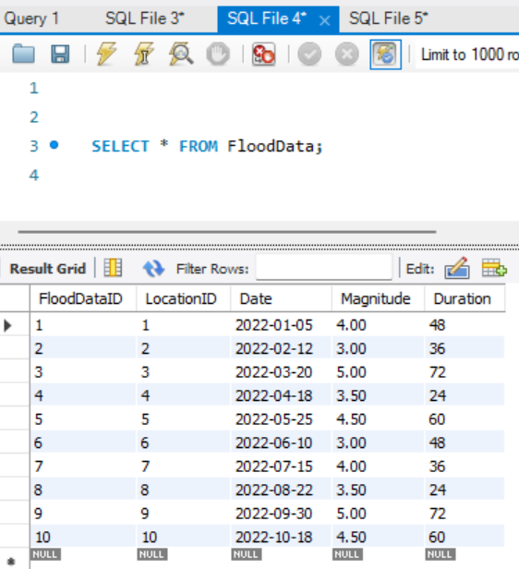
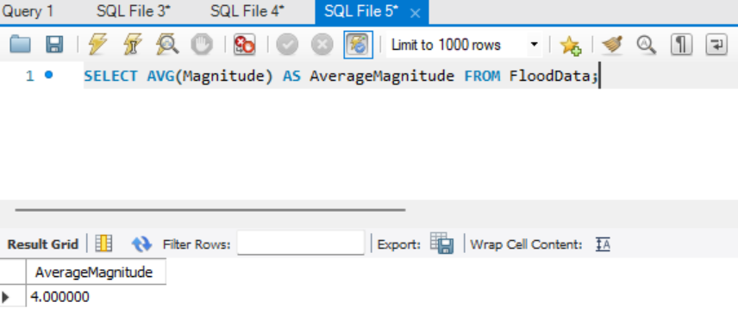
40 Queries
1) Query to Retrieve Historical Flood Data:
SELECT * FROM FloodData;
2) Query to Calculate Average Magnitude of Floods:
SELECT AVG(Magnitude) AS AverageMagnitude FROM FloodData;

Slide 26
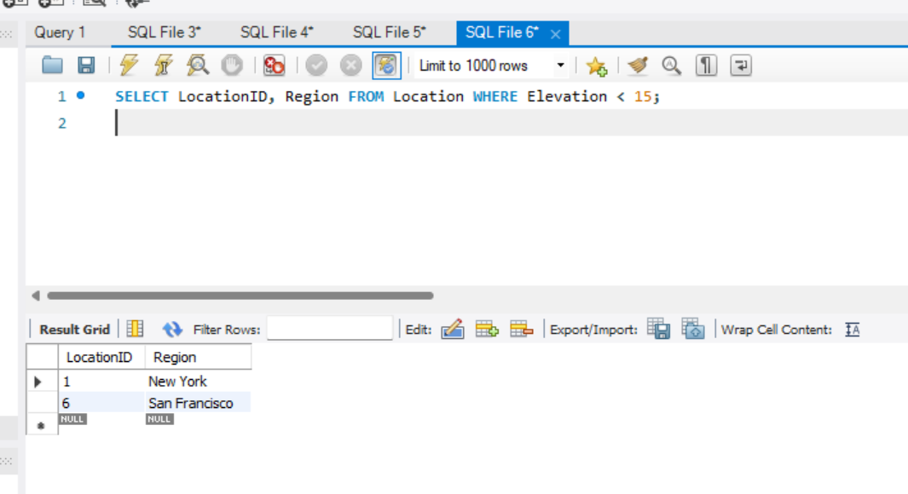
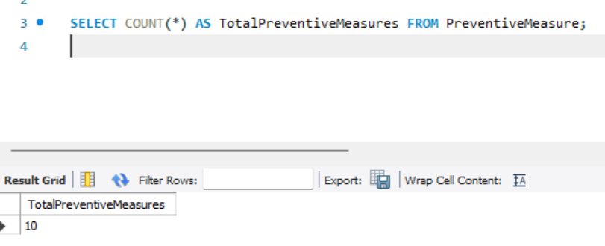
3) Query to Identify Regions with Low Elevation:
SELECT LocationID, Region FROM Location WHERE Elevation < 15;
4) Query to Retrieve Early Warning Alerts:
SELECT * FROM EarlyWarningAlert;
5) Query to Count Total Preventive Measures Implemented:
SELECT COUNT(*) AS TotalPreventiveMeasures FROM PreventiveMeasure;

Slide 27
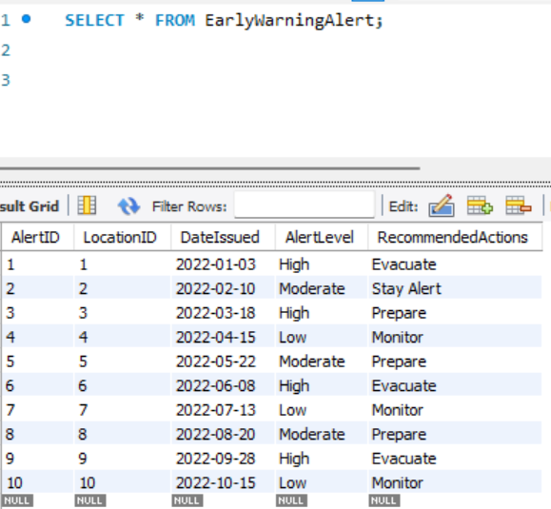
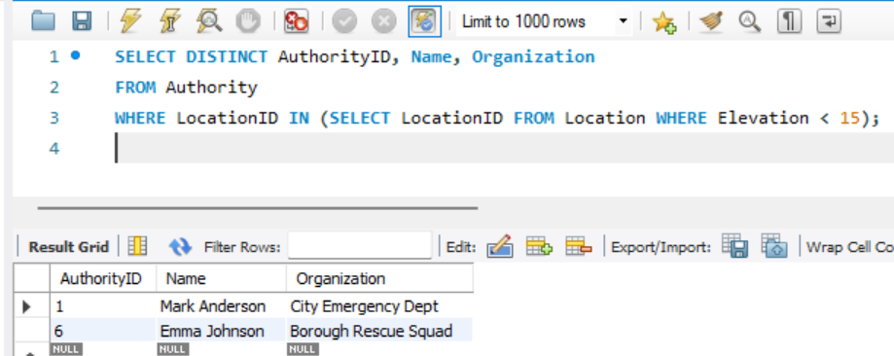
6) Query to Identify Authorities Responsible for Flood-Prone Areas:
SELECT DISTINCT AuthorityID, Name, Organization
FROM Authority
WHERE LocationID IN (SELECT LocationID FROM Location WHERE Elevation < 15);

Slide 28
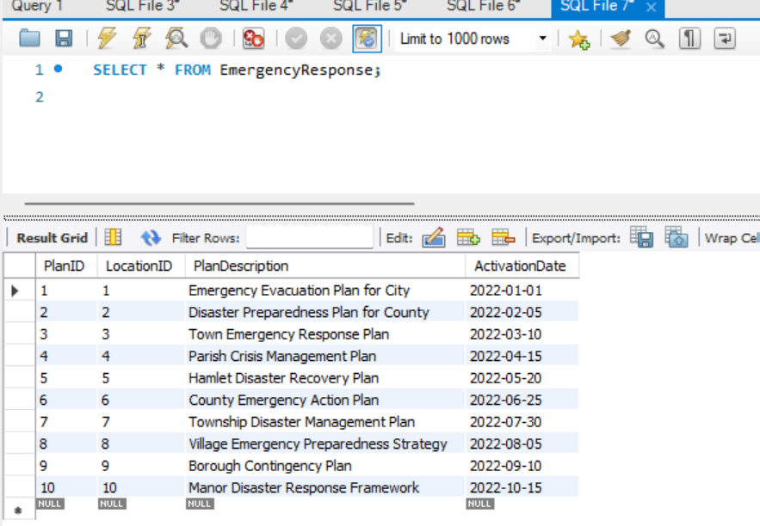
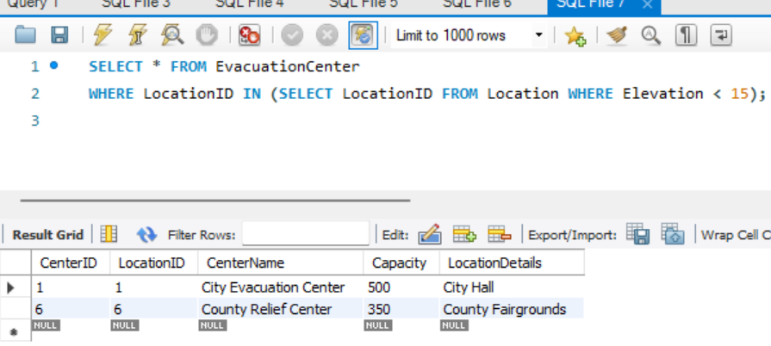
7) Query to Retrieve Activated Emergency Response Plans:
SELECT * FROM EmergencyResponse;
8) Query to List Evacuation Centers in Flood-Prone Areas:
SELECT * FROM EvacuationCenter
WHERE LocationID IN (SELECT LocationID FROM Location WHERE Elevation < 15);

Slide 29
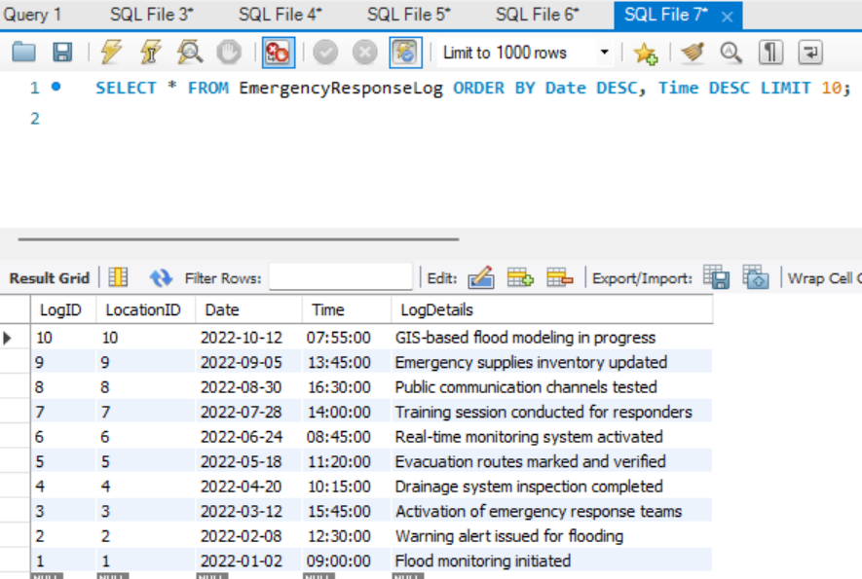
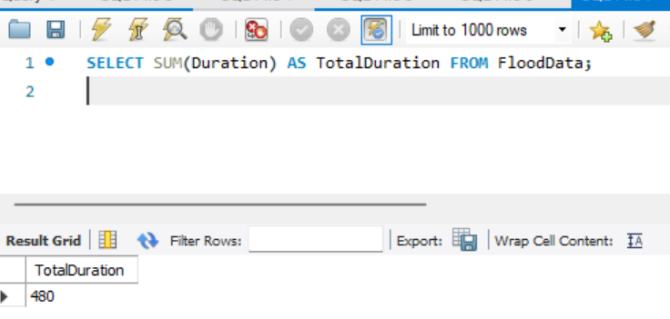
9) Query to Retrieve Recent Emergency Response Logs:
SELECT * FROM EmergencyResponseLog ORDER BY Date DESC, Time DESC LIMIT 10;
10) Query to Calculate Total Duration of Floods:
SELECT SUM(Duration) AS TotalDuration FROM FloodData;

Slide 30
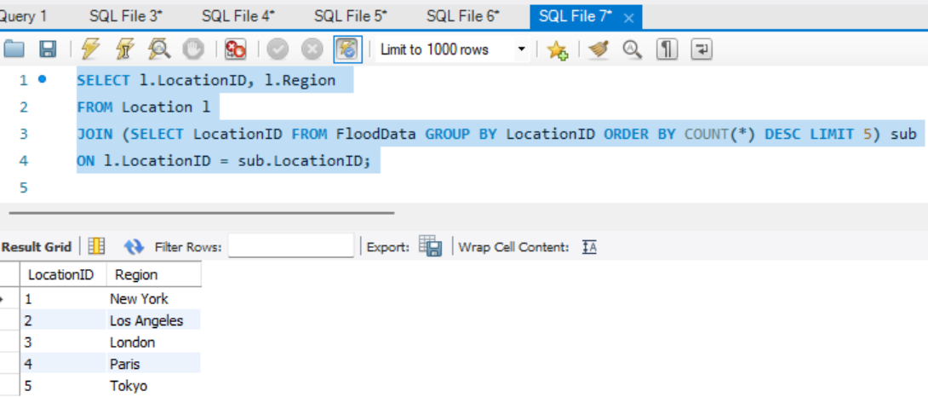
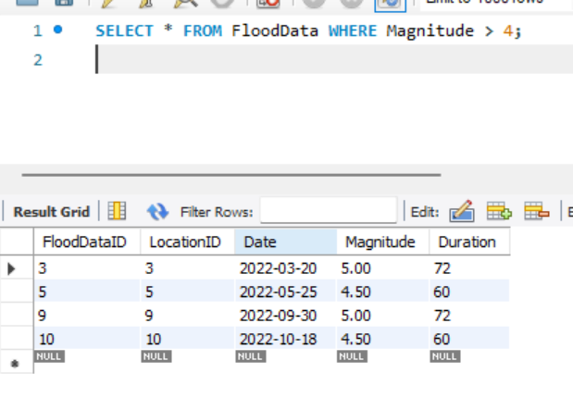
11) Query to Identify Regions Most Affected by Floods:
SELECT l.LocationID, l.Region
FROM Location l
JOIN (SELECT LocationID FROM FloodData GROUP BY LocationID ORDER BY COUNT(*) DESC LIMIT 5) sub
ON l.LocationID = sub.LocationID;
12) Retrieve all floods with magnitude greater than 4:
SELECT * FROM FloodData WHERE Magnitude > 4;

Slide 31
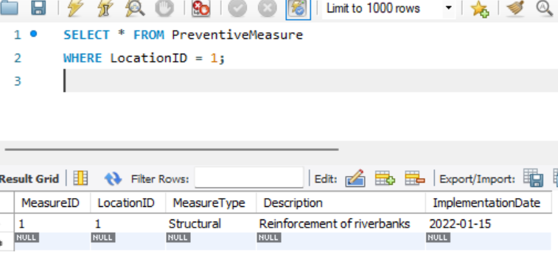
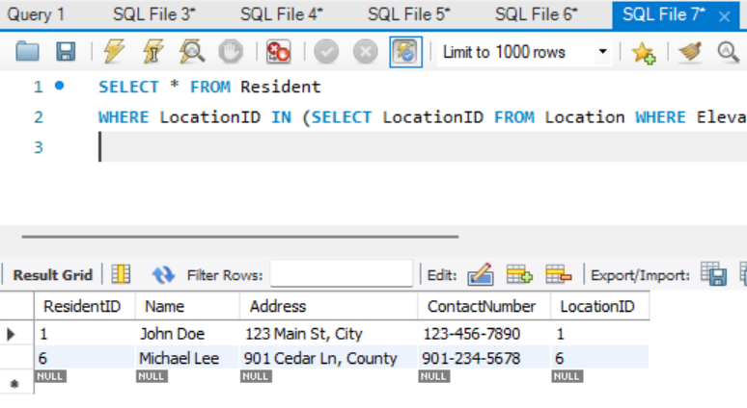
13) Retrieve preventive measures for a specific location:
SELECT * FROM PreventiveMeasure
WHERE LocationID = 1;
14) Retrieve residents in low elevation areas:
SELECT * FROM Resident
WHERE LocationID IN (SELECT LocationID FROM Location WHERE Elevation < 15);

Slide 32
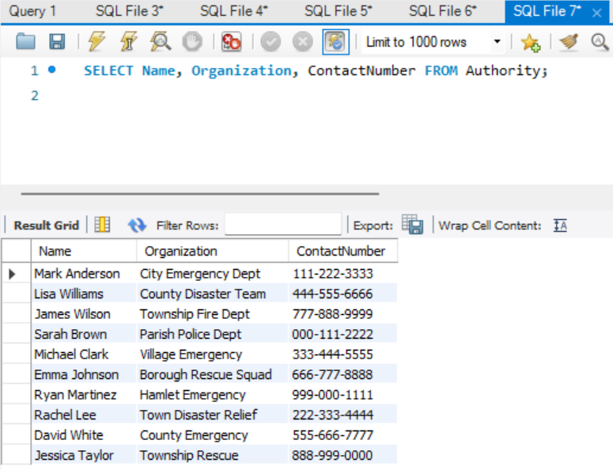
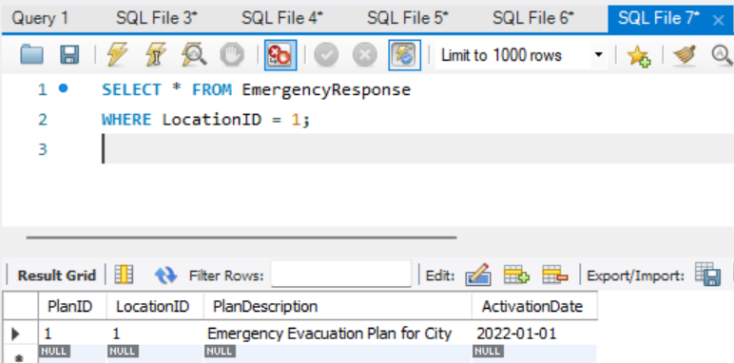
15) Retrieve authorities' contact information:
SELECT Name, Organization, ContactNumber FROM Authority;
16) Retrieve emergency response plans for a specific location:
SELECT * FROM EmergencyResponse
WHERE LocationID = 1;

Slide 33
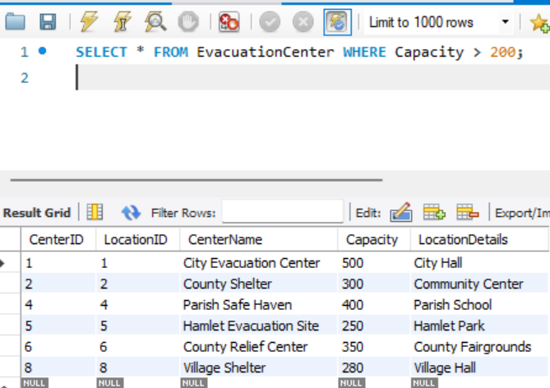
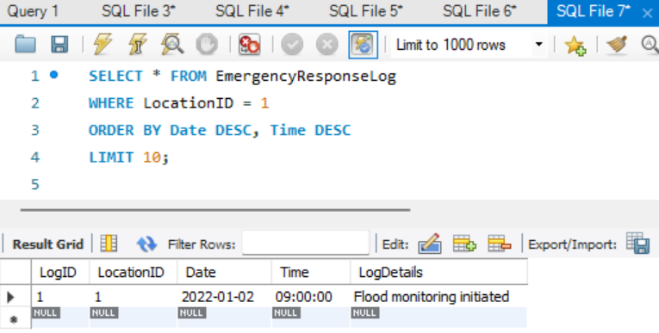
17) Retrieve evacuation centers with capacity greater than 200:
SELECT * FROM EvacuationCenter WHERE Capacity > 200;
18) Retrieve recent emergency response logs for a specific location:
SELECT * FROM EmergencyResponseLog
WHERE LocationID = 1
ORDER BY Date DESC, Time DESC
LIMIT 10;

Slide 34
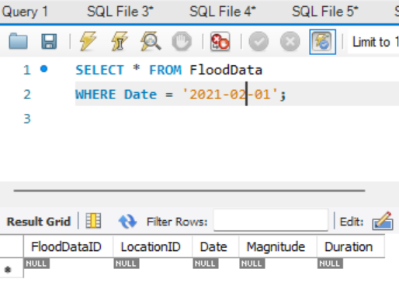
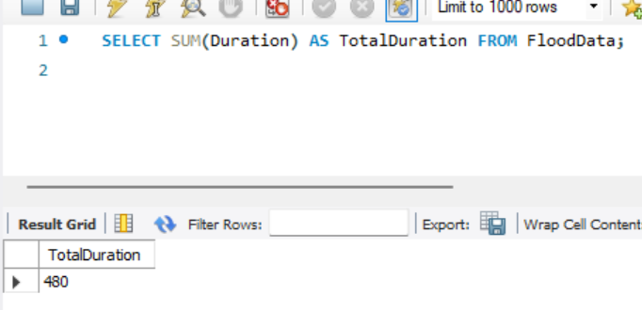
19) Retrieve flood data for a specific date:
SELECT * FROM FloodData
WHERE Date = '2022-01-01';
20) Calculate the total duration of floods:
SELECT SUM(Duration) AS TotalDuration FROM FloodData;

Slide 35
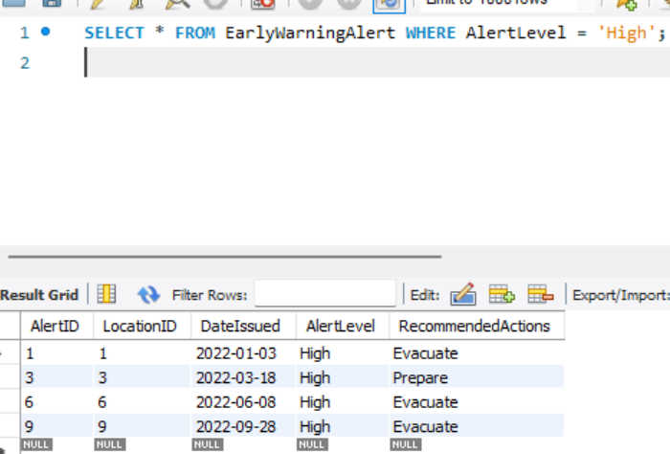
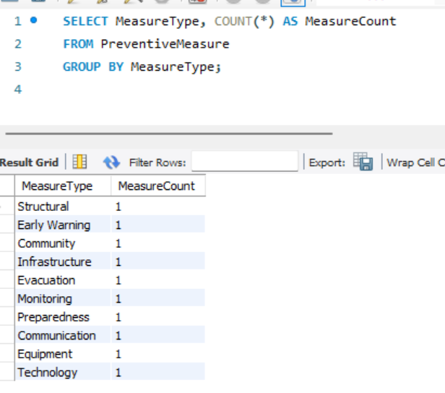
21) Retrieve all early warning alerts with high alert levels:
SELECT * FROM EarlyWarningAlert WHERE AlertLevel = 'High';
22) Count the number of preventive measures of each type:
SELECT MeasureType, COUNT(*) AS MeasureCount
FROM PreventiveMeasure
GROUP BY MeasureType;

Slide 36
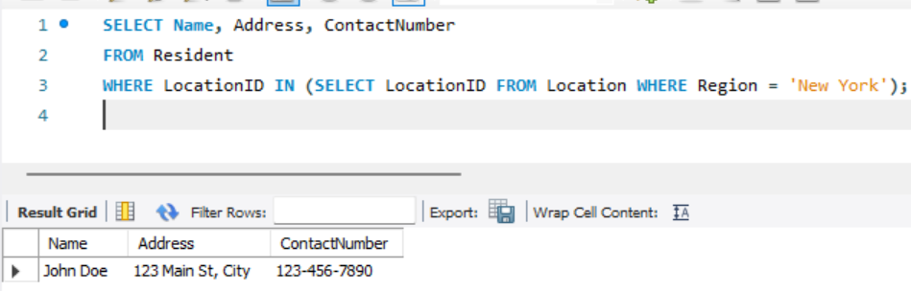
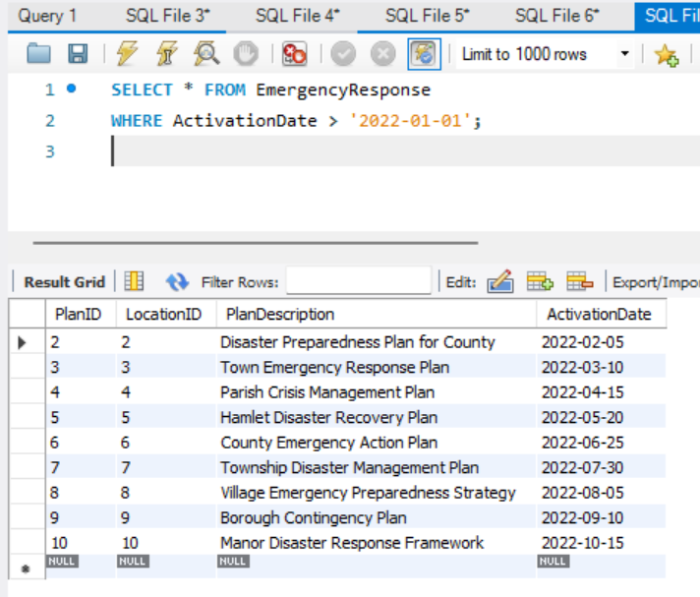
23) Retrieve residents' contact information for a specific region:
SELECT Name, Address, ContactNumber
FROM Resident
WHERE LocationID IN (SELECT LocationID FROM Location WHERE Region = 'New York');
24) Retrieve emergency response plans activated after a specific date:
SELECT * FROM EmergencyResponse
WHERE ActivationDate > '2022-01-01';

Slide 37
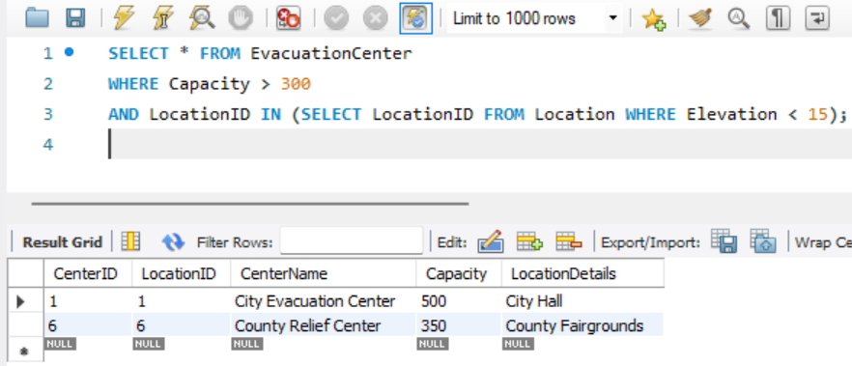
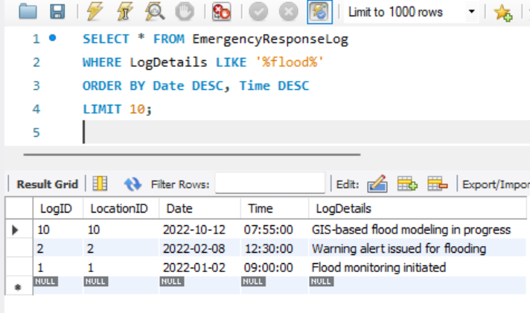
25) Retrieve evacuation centers with capacity greater than 300 and located in low elevation areas:
SELECT * FROM EvacuationCenter
WHERE Capacity > 300
AND LocationID IN (SELECT LocationID FROM Location WHERE Elevation < 15);
26) Retrieve recent emergency response logs with flood-related details:
SELECT * FROM EmergencyResponseLog
WHERE LogDetails LIKE '%flood%'
ORDER BY Date DESC, Time DESC
LIMIT 10;

Slide 38
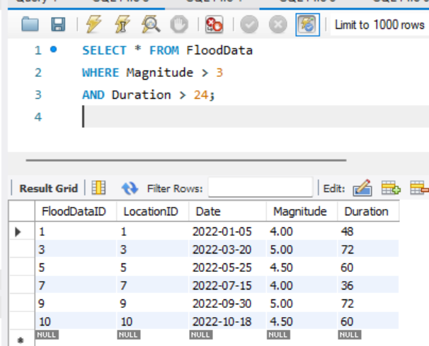
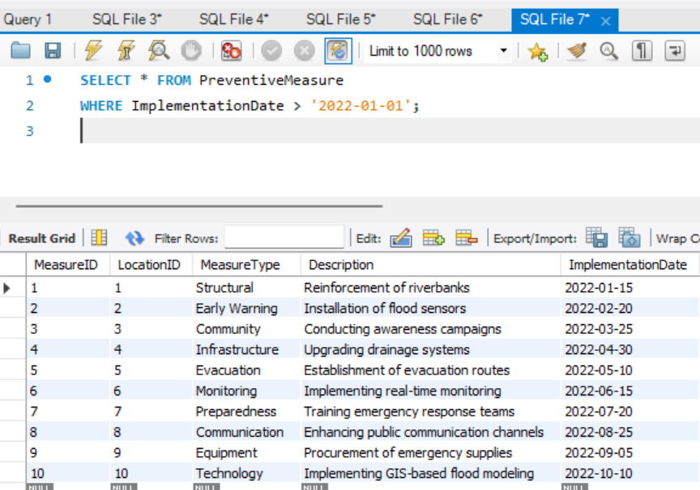
27) Retrieve flood data with magnitude greater than 3 and duration more than 24 hours:
SELECT * FROM FloodData
WHERE Magnitude > 3
AND Duration > 24;
28) Retrieve preventive measures implemented after a specific date:
SELECT * FROM PreventiveMeasure
WHERE ImplementationDate > '2022-01-01';

Slide 39
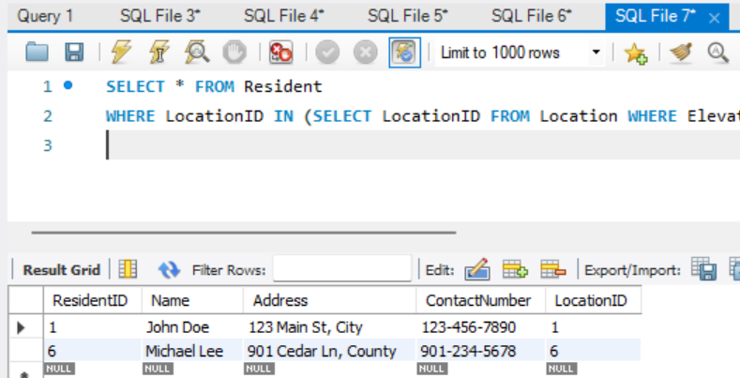
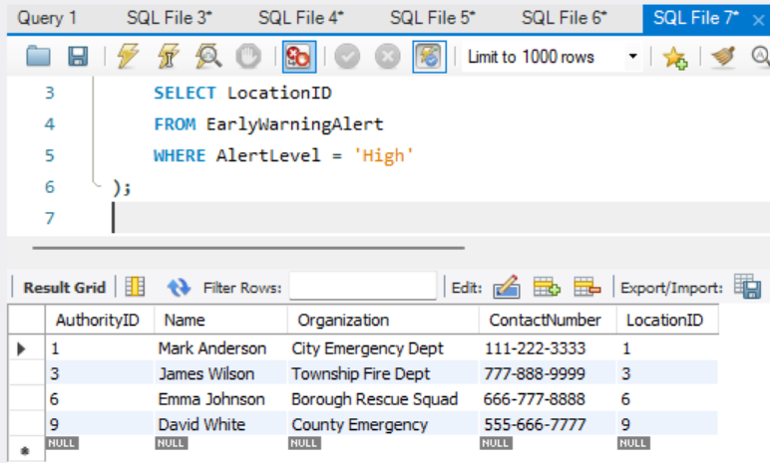
29) Retrieve residents' contact information for low elevation areas:
SELECT * FROM Resident
WHERE LocationID IN (SELECT LocationID FROM Location WHERE Elevation < 15);
30) Retrieve authorities responsible for issuing high alert early warning alerts:
SELECT * FROM Authority
WHERE LocationID IN (
SELECT LocationID
FROM EarlyWarningAlert
WHERE AlertLevel = 'High'

Slide 40
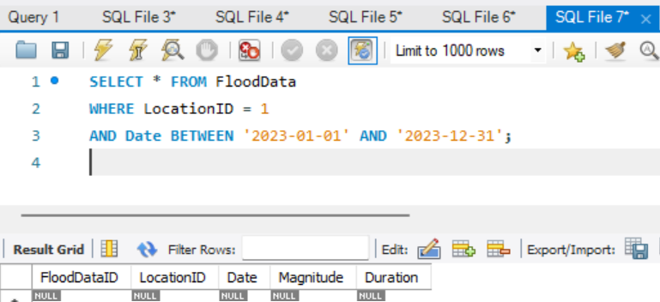
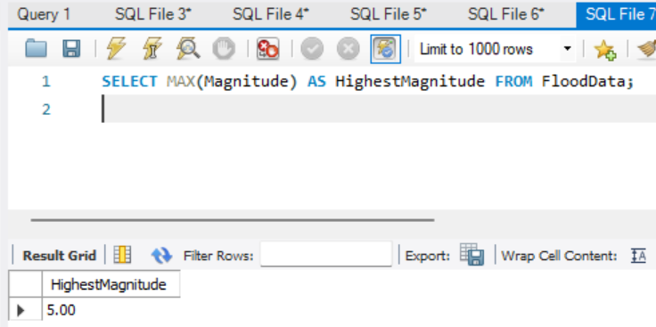
31) Retrieve flood data for a specific location and date range:
SELECT * FROM FloodData
WHERE LocationID = 1
AND Date BETWEEN '2023-01-01' AND '2023-12-31';
32) Retrieve the highest magnitude flood recorded:
SELECT MAX(Magnitude) AS HighestMagnitude FROM FloodData;

Slide 41
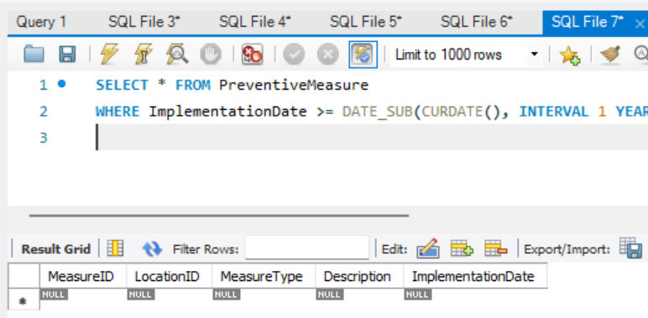
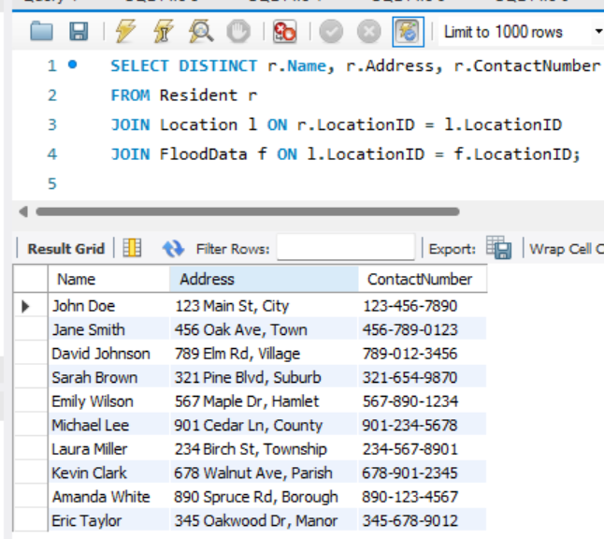
33) Retrieve preventive measures with implementation dates within the last year:
SELECT * FROM PreventiveMeasure
WHERE ImplementationDate >= DATE_SUB(CURDATE(), INTERVAL 1 YEAR);
34) Retrieve residents' contact information for regions with flood occurrences:
SELECT DISTINCT r.Name, r.Address, r.ContactNumber
FROM Resident r
JOIN Location l ON r.LocationID = l.LocationID
JOIN FloodData f ON l.LocationID = f.LocationID;

Slide 42
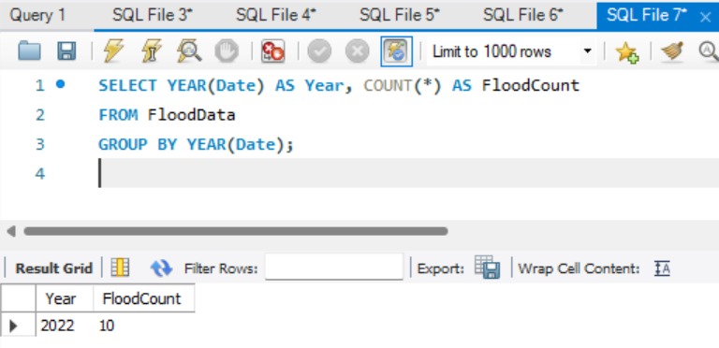
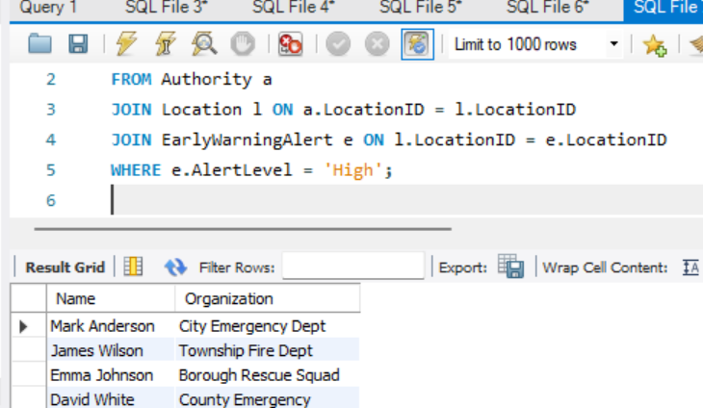
35) Count the number of floods per year:
SELECT YEAR(Date) AS Year, COUNT(*) AS FloodCount
FROM FloodData
GROUP BY YEAR(Date);
36) Retrieve authorities for regions with flood occurrences and high alert levels:
SELECT DISTINCT a.Name, a.Organization
FROM Authority a
JOIN Location l ON a.LocationID = l.LocationID
JOIN EarlyWarningAlert e ON l.LocationID = e.LocationID
WHERE e.AlertLevel = 'High';

Slide 43
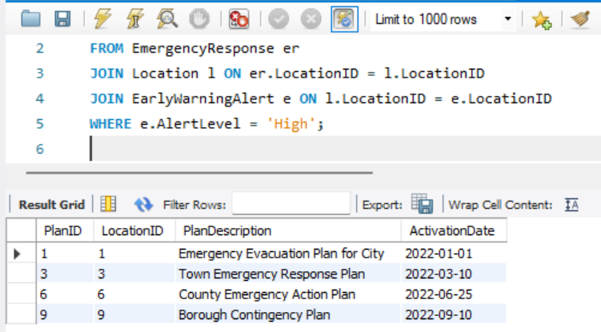
37) Retrieve emergency response plans for regions with flood occurrences and high alert levels:
SELECT DISTINCT er.*
FROM EmergencyResponse er
JOIN Location l ON er.LocationID = l.LocationID
JOIN EarlyWarningAlert e ON l.LocationID = e.LocationID
WHERE e.AlertLevel = 'High';
38) Retrieve evacuation centers with available capacity for a specific region:
SELECT ec.*
FROM EvacuationCenter ec
JOIN Location l ON ec.LocationID = l.LocationID
WHERE l.Region = 'New York'
AND ec.Capacity > 0;

Slide 44
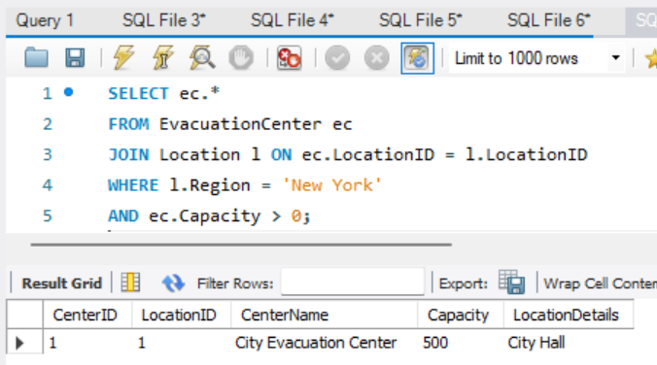
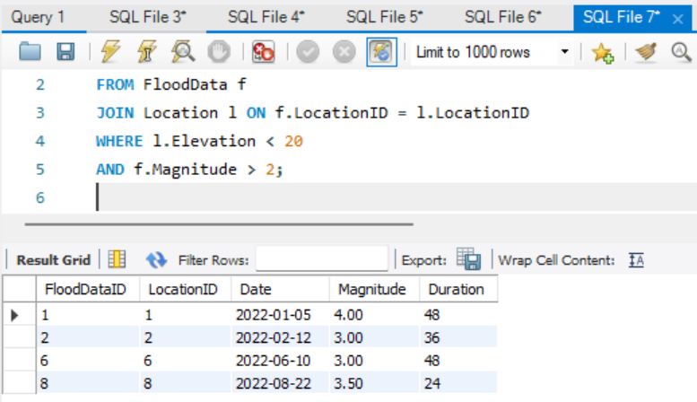
39) Retrieve flood data for regions with elevation less than 20 and magnitude greater than 2:
SELECT f.*
FROM FloodData f
JOIN Location l ON f.LocationID = l.LocationID
WHERE l.Elevation < 20
AND f.Magnitude > 2;

Slide 45
FINAL RESULT OF THIS PROJECT:
1. Analyzing Historical Flood Data for All Cities
SELECT fd.*, l.Region AS Location
FROM FloodData fd
JOIN Location l ON fd.LocationID = l.LocationID;
2. Average Magnitude of Floods in Each Region
SELECT l.Region AS Location, AVG(fd.Magnitude) AS AverageMagnitude
FROM Location l
JOIN FloodData fd ON l.LocationID = fd.LocationID
GROUP BY l.Region;
3. Early Warning Alerts for All Cities
SELECT ewa.*, l.Region AS Location
FROM EarlyWarningAlert ewa
JOIN Location l ON ewa.LocationID = l.LocationID;

Slide 46
-- 4. Preventive Measures for All Cities
SELECT pm.*, l.Region AS Location
FROM PreventiveMeasure pm
JOIN Location l ON pm.LocationID = l.LocationID;
-- 5. Emergency Response Plans for All Cities
SELECT er.*, l.Region AS Location
FROM EmergencyResponse er
JOIN Location l ON er.LocationID = l.LocationID;
-- 6. Evacuation Centers for All Cities
SELECT ec.*, l.Region AS Location
FROM EvacuationCenter ec
JOIN Location l ON ec.LocationID = l.LocationID;

Slide 47
-- 7. Query 7 Description
SELECT * FROM YourTableName WHERE YourCondition;
-- 8. Retrieve Emergency Response Logs for All Cities
SELECT erl.*, l.Region AS Location
FROM EmergencyResponseLog erl
JOIN Location l ON erl.LocationID = l.LocationID;
-- 9. Retrieve Authorities for All Cities
SELECT a.*, l.Region AS Location
FROM Authority a
JOIN Location l ON a.LocationID = l.LocationID;
-- 10. Flood Data for All Cities
SELECT fd.*, l.Region AS Location
FROM FloodData fd
JOIN Location l ON fd.LocationID = l.LocationID;

Slide 48
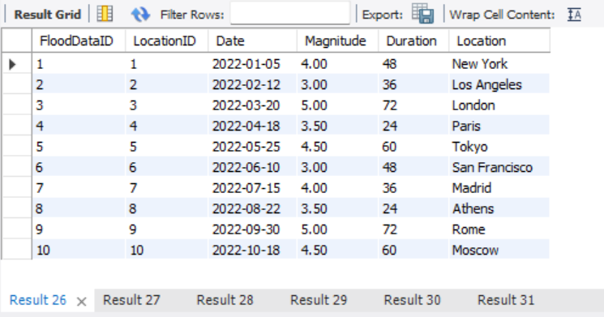




Slide 49



